Slide 1
AI SocioEconomic Frontier
Large Language Model make SocioEconomic Research Simplier
Reporter：Shen ZeKai

Slide 2
CONTENTS
1
Problem
2
Solution
3
Innovative & Orignality
4
Business idea

Slide 3
1
Problem

Slide 4


Problem
Identify the research field
Find the relevant keywords
1
2
Searching
Search for relevant literature based on keywords

Slide 5


Problem
Identify the research field
Find the relevant keywords
Download,read and Organizate the literature
1
2
3
4
Searching
Reading
Search for relevant literature based on keywords
Select the relevant
Remove non-essential

Slide 6


Problem
Identify the research field
Find the relevant keywords
Download,read and Organizate the literature
Create an outline
Draft literature review
1
2
3
4
5
6
Searching
Reading
Writing
Search for relevant literature based on keywords
Select the relevant
Remove non-essential
Refine the language
Review the theme of the research topic
Too Complicated！！！

Slide 7
2
Solution

Slide 8
Solution
simpler
&
efficient
Simpler search
Modifiable literature review
Input keywords
Directly view relevant literature
Lower search costs, better retrieval results
Engage in conversation with the literature
Extract the desired information
Modify the literature review
More relevant literature
One-step completion
Using text embedding algorithms
Classification and select based on your research idea
Read while searching and simultaneously accomplish writing

Slide 9
Solution
Now we giving youLit-tool

Slide 10
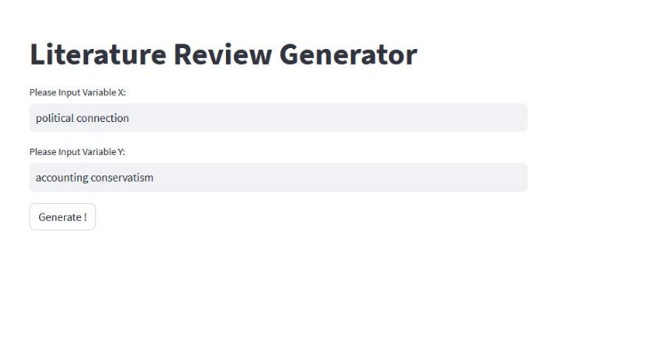

Solution

Slide 11
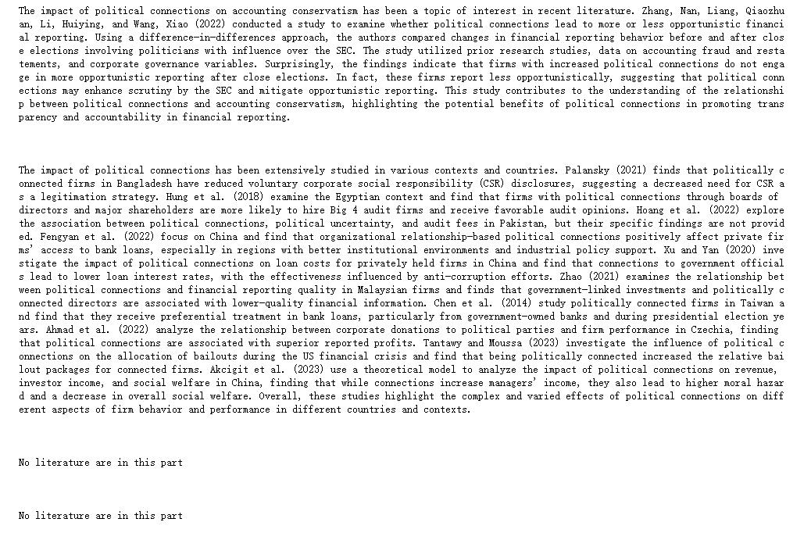
Return：
Solution

Slide 12
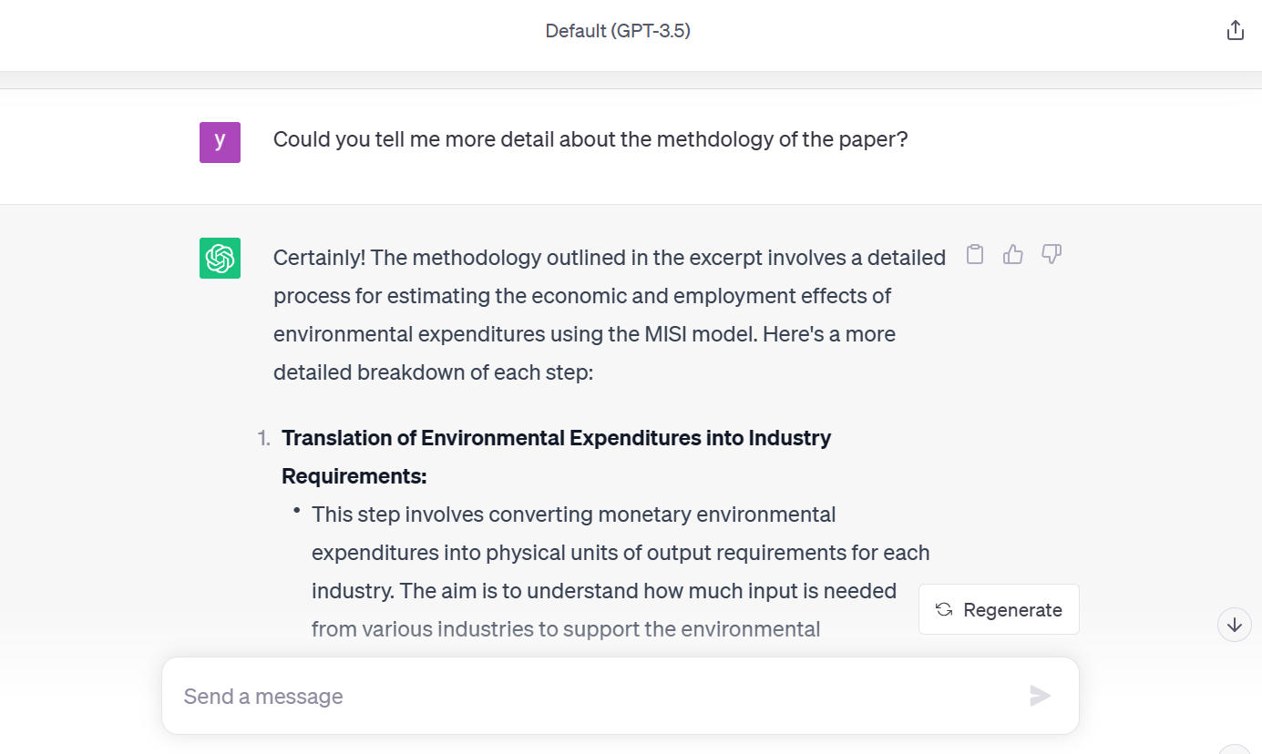
Solution

Slide 13
3
Innovative & Orignality

Slide 14



Innovative & Orignality
Search and directly download PDF

Slide 15




Innovative & Orignality
Search and directly download PDF
PDF Generate
Vector Database
Professional experts use Langchain for Prompt Engineering

Slide 16



Innovative & Orignality
PDF Generate
Vector Database
Segment the content based on the section
Search and directly download PDF
Key
Information
Professional experts use Langchain for Prompt Engineering

Slide 17

Innovative & Orignality
PDF Generate
Vector Database
Segment the content based on the section
Search and directly download PDF
Key
Information
LLMs
Generate/Modify
Literature
Review
Professional experts use Langchain for Prompt Engineering

Slide 18

Innovative & Orignality
Chat
PDF Generate
Vector Database
Segment the content based on the section
Search and directly download PDF
Key
Information
LLMs
Generate/Modify
Literature
Review
Professional experts use Langchain for Prompt Engineering

Slide 19
Innovative & Orignality
Segment the article
Segment the content based on the section
Higher accuracy results
Not arbitrary assembling

Slide 20
Innovative & Orignality
Topic clustering
Utilizing word vector matching
Internal logic coherence

Slide 21

Innovative & Orignality
Interactive editing
Communicate with ChatGPT
More information
Modify the content

Slide 22
4
Business idea

Slide 23
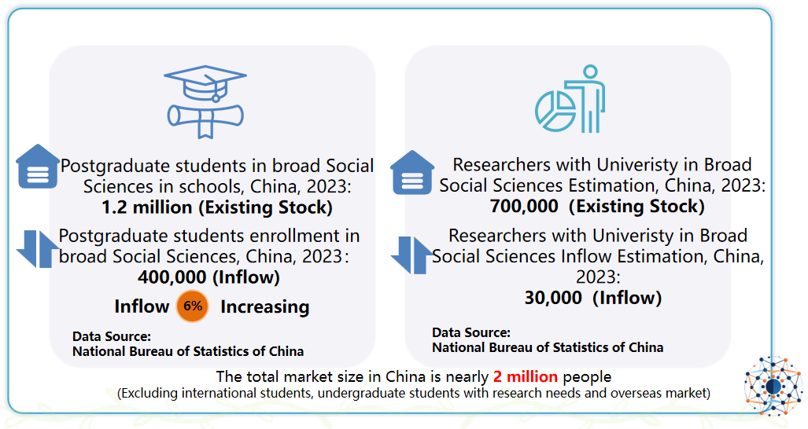
Business idea
Market Size 1.2 million postgraduate + 0.7 million researcher

Slide 24
AI SocioEconomic Frontier
Large Language Model make SocioEconomic Research Simplier
Thank for your time!
Team leader： Shen Zekai
Team member： Lu WenTao
Dong YuanYuan

